Slide 1
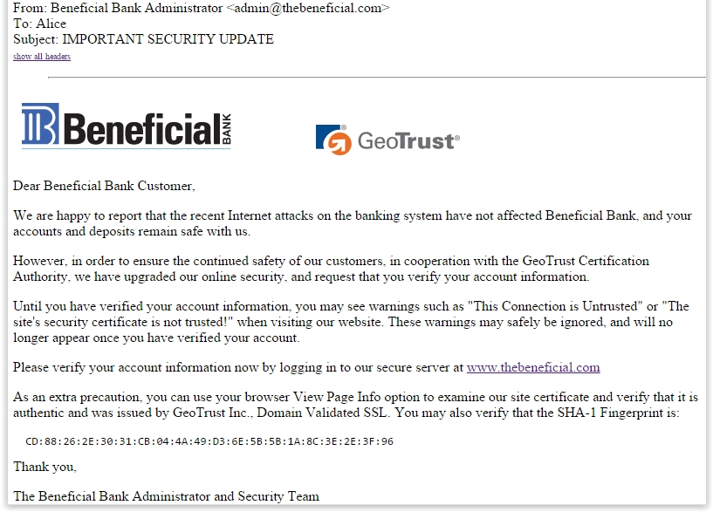
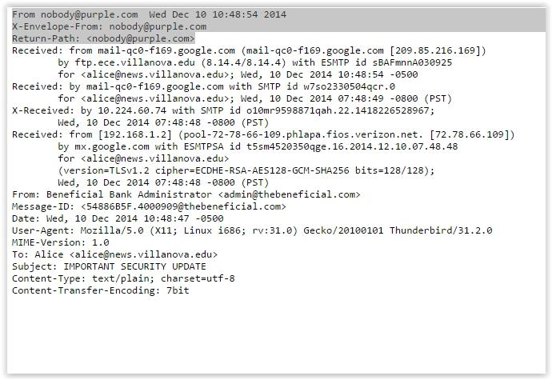
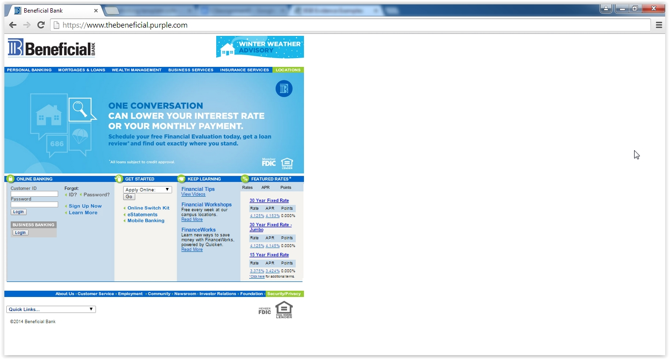
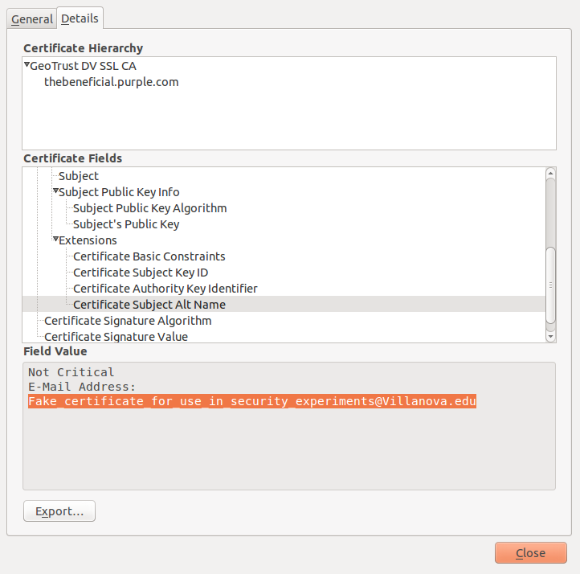
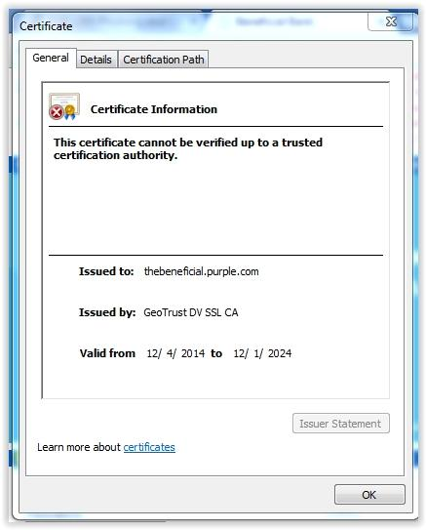
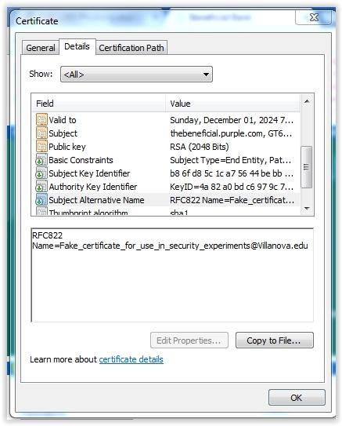
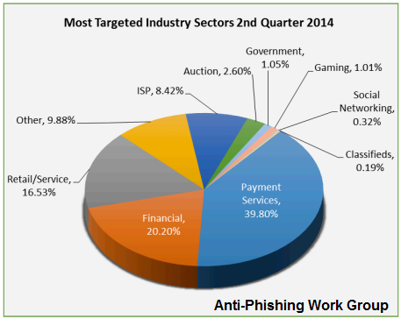
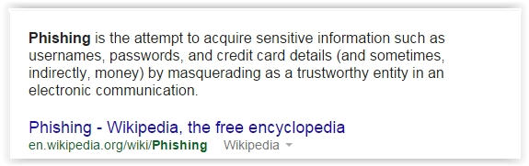
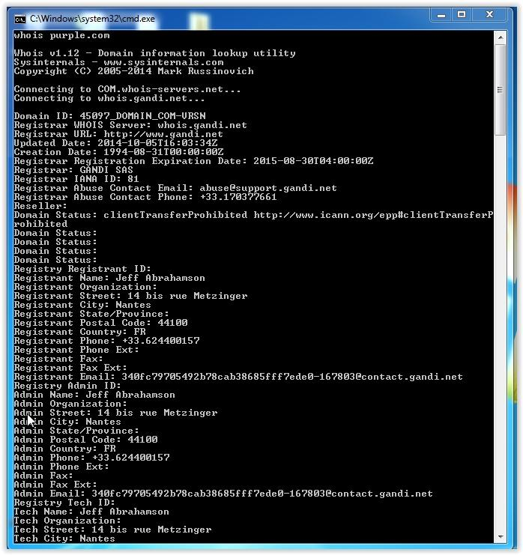
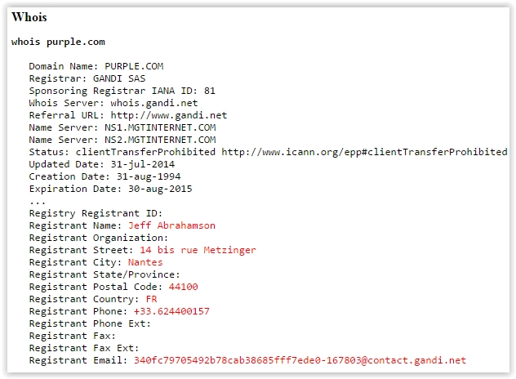
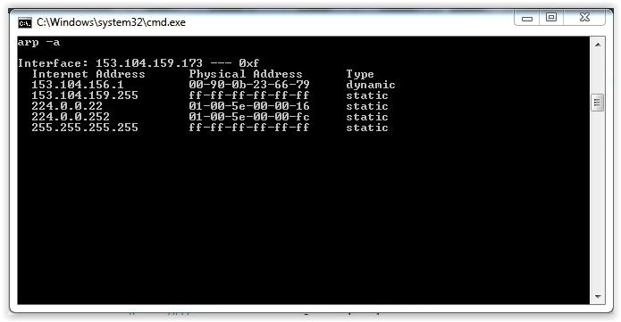
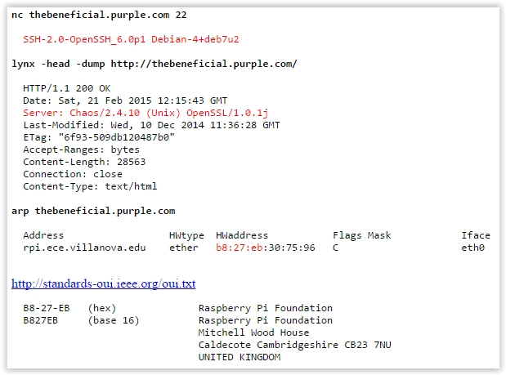
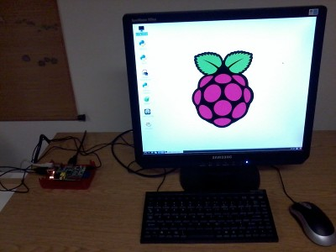
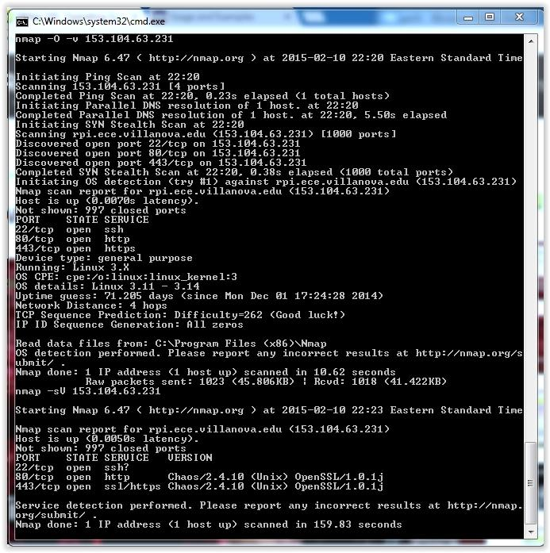
Phishing: The Art of Catching your Personal Data
EGR 1205 Poster Presentation Day
March 2015
Student Names: Sean Carroll, Matt Kelly, John Lauer
Anomalies in the Email
W
Anomalies in the Certificates
What is Phishing?
Anomalies in Email Content
Customer’s name is not used, instead it just says “Dear Beneficial Bank Customer”
Each sentence has its own line which seems suspicious
“This connection is untrusted” or “The site’s security certificate is not trusted!” is a clear sign that the website is a fraud
Hyperlink does not actually bring you www.thebeneficial.com
Last sentence the email gives you a SHA-1 fingerprint
The beneficial bank image also takes you to the wrong website.
Email header also reveals that the email was sent from nobody@purple.com
Issuer statement from GeoTrust was not able to be accessed because the button was grayed out
Subject Alternative Name is Fake_certificate_for_use_in_security_experiments@villanova.edu
Official hostname of the fake bank website was rpi.ece.villanova.edu
The IP was 153.104.63.231 which shows that it is coming from Villanova’s campus
Uniform Resource Identifier (URL) displays revised bank website from a different server address.
Who
C
Whois Lookup Of IP Address
Software & Hardware Info
Conclusion of Responsibility
The person responsible for the attack was Jeff Abrahamson of Nantes, France, 44100.
His phone number is +33.624400157.
His email is 340fc79705492b78cab38685fff7ede0-167803@contact.gandi.net.
We used the ping command to activate the arp command on the original IP of 153.104.63.231.
We found a mac address that was a 6 part, 2 digit hexadecimal code that we then looked up to find the product manufacturer of the address.
We found that the hardware was from a vendor named Lanner Electronics.
Software running on the website is chaos 2.4.10 which we found using nmap.
The computer running the website is using Linux 3.11-3.14.
It is also running ssh, http, and https.
The physical location of the fake bank website is Villanova University, 800 East Lancaster Avenue, Villanova, PA 19085
Located in Tolentine room 231
The IP adress is 153.104.63.231
Notes:
‹#›

